Slide 1
Java: An introduction

Slide 2
Java…
is an Object oriented language
has syntax similar to C/C++
is portable/platform independent
is secure
is strongly-typed

Slide 3
Flavors
JSE
  Java Standard Edition formerly known as J2SE.
  This forms the core part of java language.
JEE
  Java Enterprise Edition formerly known as J2EE.
  These are the set of packages that are used to develop distributed enterprise-scale application.
  These applications are deployed on JEE application servers.
JME
  Java Micro Edition formerly known as J2ME.
  These are the set of packages is used to develop application for mobile devices and embedded systems.

Slide 4
Hello World in Java
Hello.java
public class Hello{
public static void main( String args[])
{
System.out.println(“Hello World!”);
}}
Special statement used to display data on console. ‘println’ causes the next print statement to be printed in the next line.
main() is a method from where program execution begins.

Slide 5
Save, Compile and Execute the code from command prompt
Compile
  C:\MyJava>javac Hello.java
Execute
  C:\MyJava>java Hello

Slide 6
The inside story of compilation and execution
Source code
Byte code
Hello.class
javac
Hello.java
compilation
Byte code
Hello.class
Platform specific code
java
execution

Slide 7
JDK, JRE and JVM
JDK
Java Predefined Classes
JVM
…
Date
…
…
String
Math
JRE
javac, java, javadoc …
Java Executables
Is JVM platform independent?

Slide 8

Object orientation
A bulb:
It’s a real-world thing.
A thing we manufacture that can be switched on to generate light and switched off.
It has real features like the glass covering, filament and holder.
It also has conceptual features like power.
A bulb manufacturing factory produces many bulbs based on a basic description / pattern of what a bulb is.
called an object in OOP
called methods in OOP
called attributes / member variables in OOP
called a class in OOP

Slide 9
Object
A thing in a real world can be either physical or conceptual. An object in object oriented programming can be real or conceptual.
Conceptual objects are entities that are not tangible in the way real-world objects are
Bulb is a real object. While college is a conceptual object.
Conceptual objects may not have a real world equivalent. For instance, a Stack object in a program.

Slide 10
A java class
public data member
public class College{
public String name;
public void display(){
System.out.print(“Welcome to “);
System.out.println(name);
}
public static void main(
String args[]){
College collegeObject= new College();
collegeObject.name=“XYZ College”;
collegeObject.display();
}}
public member function
Within member function current object is assumed
Creating collegeObject
Accessing members of ‘collegeObject’.

Slide 11


What if the main is in another class?
Since the main method is used to test College class it can be in another class as well, no problem like in the next slide. Only thing that we need to ensure is that the class that has main method can access the College class. If both the classes are in the same directory then they can access each other, otherwise, we need to set something called classpath.

Slide 12
public class College{
public String name;
public void display(){
System.out.print(“Welcome to “);
System.out.println(name);}
}
public class CollegeTest{
public static void main(String args[]){
College collegeObject= new College();
collegeObject.name=“XYZ College”;
collegeObject.display();} }
C:\MyJava\College.java
C:\MyJava\CollegeTest.java

Slide 13
To successfully compile CollegeTest, College.class must be in the classpath
To set the classpath temporarily in command line
In the command prompt, enter the command
SET CLASSPATH=C:/MyJava;%CLASSPATH%;.
3. Go to D:\MyJava and compile CollegeTest.java.
4. Execute CollegeTest class (because that is where the main method is !)

Slide 14
Types of Errors
Compilation error : generated by the compiler. Examples of situation when it arises:
  incorrect syntax
  if keywords are used as variables
  Bracket mismatch
  Unreachable code: while(false){…}
Run-time error : generated by the JVM. Examples of situation when it arises:
  Attempt to divide an integral value by 0.
  Trying to access a class that does not exist at runtime. (What happens if you delete College.class and then run CollegeTest.class.

Slide 15

Comments
3 kinds
  Single line comment : //
  Multi-line comment: /* */
  Documentation Comment : /** */
For all predefined Java classes, Sun supplies HTML documentation which you can download from the oracle’s site.

Slide 16
/** This class is used to represent a college.
* @author Krishnan
* @version 1.0, 08/16/2010
*/
public class College{
/** Name of the college */
public String name;
/** This method is used to display and return the welcome message.
* @param user is the name of the user
* @return returns the welcome message
*/
public String display(String user){
String str="Hello " + user +“, Welcome to "+ name;
System.out.print(str);
return str;
}

Slide 17
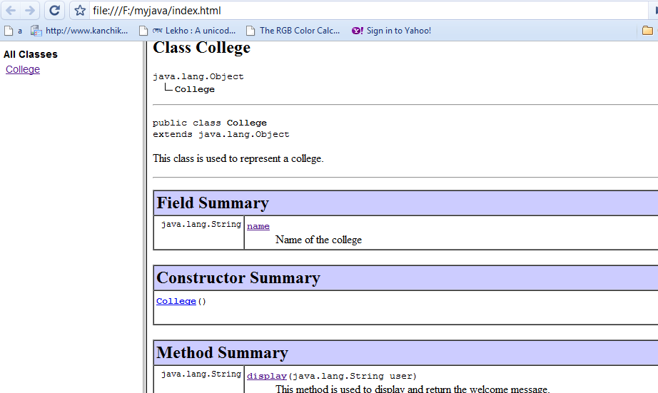
/** This is where the program execution begins.*/
public static void main(String args[]){
College collegeObject= new College();
collegeObject.name="XYZ College";
collegeObject.display("Deepa");}
}
Use the following command to generate java documentation.
javadoc College.java
Check out the files that are generated. Did you notice where the commented lines are inserted ?

Slide 18
Nesting comments
Valid Nesting
/* // */ /** // */
///* */ // /** */
Invalid Nesting
/* */ and /** */ nested with itself and nested with each other gives error.
/* /* */ */
/** /* */ */

